Slide 1
Chapter 5
Interconnecting the LANs

Slide 2
Chapter Objective
Describe how a bridge is used to interconnect LANs.
Describe how a switch is used to interconnect LANs.
Discuss the advantages of using a switch instead of a hub

Slide 3
Chapter Objectives
Describe the function of a router when used to interconnect LANs
Describe the interface associated with a router
Describe the function of a gateway in a computer network
Describe the concept of a network segment
Describe the concept of auto-negotiation
Describe the steps (software and hardware) for connecting to a router’s console port

Slide 4
Interconnecting the LANs
Interconnecting LANs in a campus network or even interconnecting LANs in a wide area network (WAN) incorporate similar concepts and issues.
The campus network is a collection of two or more interconnected LANs. Either can be within a building or housed externally in multiple buildings.

Slide 5
Network Bridge
A bridge is used in computer networks to interconnect two LANs together and separate network segments.
A segment is a section of a network separated by bridges, switches, and routers.
The bridge is a layer 2 device in the OSI model, meaning that it uses the MAC address information to make decisions regarding forwarding data packets. Only the data that needs to be sent to across the bridge to the adjacent network segment is forwarded.

Slide 6
Port1
Port 2
An example of using a bridge to segment two Ethernet LANs is shown. The picture shows that LAN A connects to port 1 of the bridge and LAN B connects to port 2 on the bridge. This creates two segments as shown in the picture. There are four computers in LAN A and three computers in LAN B.
Bridge
Segment
LAN A
Computer 1
Computer 2
Computer 3
Computer 4
LAN B
Computer 5
Computer 6
Computer 7
Fig. 4-2 Using a bridge to interconnect two Ethernet LANs.

Slide 7
Port1
Port 2
An example of using a bridge to segment two Ethernet LANs is shown. The picture shows that LAN A connects to port 1 of the bridge and LAN B connects to port 2 on the bridge. This creates two segments as shown in the picture. There are four computers in LAN A and three computers in LAN B.
Bridge
Segment
LAN A
Computer 1
Computer 2
Computer 3
Computer 4
LAN B
Computer 5
Computer 6
Computer 7
Fig. 4-2 Using a bridge to interconnect two Ethernet LANs.

Slide 8
Port1
Port 2
An example of using a bridge to segment two Ethernet LANs is shown. The picture shows that LAN A connects to port 1 of the bridge and LAN B connects to port 2 on the bridge. This creates two segments as shown in the picture. There are four computers in LAN A and three computers in LAN B.
Bridge
Segment
LAN A
Computer 1
Computer 2
Computer 3
Computer 4
LAN B
Computer 5
Computer 6
Computer 7
Using a bridge to interconnect two Ethernet LANs.

Slide 9
Port1
Port 2
An example of using a bridge to segment two Ethernet LANs is shown. The picture shows that LAN A connects to port 1 of the bridge and LAN B connects to port 2 on the bridge. This creates two segments as shown in the picture. There are four computers in LAN A and three computers in LAN B.
Bridge
Segment
LAN A
Computer 1
Computer 2
Computer 3
Computer 4
LAN B
Computer 5
Computer 6
Computer 7
Using a bridge to interconnect two Ethernet LANs.

Slide 10
Port1
Port 2
An example of using a bridge to segment two Ethernet LANs is shown. The picture shows that LAN A connects to port 1 of the bridge and LAN B connects to port 2 on the bridge. This creates two segments as shown in the picture. There are four computers in LAN A and three computers in LAN B.
Bridge
Segment
LAN A
Computer 1
Computer 2
Computer 3
Computer 4
LAN B
Computer 5
Computer 6
Computer 7
Using a bridge to interconnect two Ethernet LANs.

Slide 11
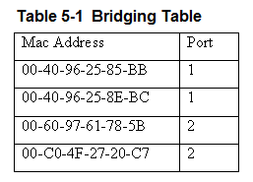
The bridges use the MAC addresses to build a bridging table of MAC addresses and port locations for hosts connected to the bridge ports.
An example of the information contained in a bridging table is provided.
Table 5-1 Bridging Table

Slide 12
The table shows the stored MAC address and the port where the address was obtained.
The source MAC address is stored into the bridge table as soon as a host talks (transmits a data packet) on the LAN.
Table 5-1 Bridging Table

Slide 13
For example, if computer 1 in LAN A sends a message to computer 2 the bridge will store the MAC addresses of both computers and record that both of these computers are connected to port 1.
Port1
Port 2
Bridge
Segment
LAN A
Computer 1
Computer 2
Computer 3
Computer 4
LAN B
Computer 5
Computer 6
Computer 7

Slide 14
If computers 5 or 6 are placing data packets on the network then the source MAC addresses for 5 and 6 are stored in the bridge table and it is recorded that these computers connect to port 2 on the bridge.
Port1
Port 2
Bridge
Segment
LAN A
Computer 1
Computer 2
Computer 3
Computer 4
LAN B
Computer 5
Computer 6
Computer 7

Slide 15
The bridge monitors the data on its ports to check for an association between the destination MAC address of the Ethernet frames to any of the hosts connected to its ports. An association indicates that the destination MAC address for a host is connected to one of the ports on the bridge.
Port1
Port 2
Bridge
Segment
LAN A
Computer 1
Computer 2
Computer 3
Computer 4
LAN B
Computer 5
Computer 6
Computer 7

Slide 16
If an association is found, the data is forwarded to that port. For example, assume that Computer 1 sends a message to Computer 5. The bridge detects an association between the destination MAC address for Computer 5 and port 2. The bridge then forwards the data from Computer 1 to Computer 5 in LAN B via port 2.
Port1
Port 2
Bridge
Segment
LAN A
Computer 1
Computer 2
Computer 3
Computer 4
LAN B
Computer 5
Computer 6
Computer 7

Slide 17
Association
The capability of a bridge to only forward data packets when there is an association is used to isolate data traffic in each segment.

Slide 18
Broadcasts
A potential problem with bridges has to do with the way broadcasts are handled. All broadcasts in a LAN will be forwarded to all hosts connected within the bridged LANs.
For example, the broadcast associated with an ARP will appear on all hosts. In the address resolution protocol, a broadcast is sent to all hosts in a LAN connected to the bridge.

Slide 19
Broadcasts
The bridge forwards all broadcasts. Therefore, an ARP request broadcasting the message “who has this IP address” is sent to all hosts on the LAN.
The data packets associated with ARP requests are small but it requires computer time to process each ARP request.
Excessive amounts of broadcasts being forwarded by the bridge can lead to a broadcast storm resulting in degraded network performance in terms of a network slowdown.

Slide 20
Bridge Table – Expiration Counter
The MAC address entries stored in a bridge table are temporary. Each MAC address entry to the bridge table remains active as long as there is periodic data traffic activity from that host on its port.
However, an entry into the table is deleted if the port becomes inactive. In other words, the entries stored into the table will have a limited lifetime.
An expiration timer will commence once the MAC address is entered into the bridge table. The lifetime for the entry is renewed by new data traffic by the computer and the MAC address is reentered.

Slide 21
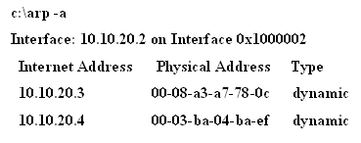
All networking devices (e.g., computers) contain an ARP cache, temporary storage of MAC addresses recently contacted. This is also called the ARP table.
The ARP cache holds the MAC address of a host and this enables the message to be sent directly to the destination MAC address without the computer having to issue an ARP request for MAC address.
The ARP cache contents on a Windows computer can be viewed using the arp –a command while in the command prompt, as shown.

Slide 22

This message is generated if all of the ARP entries have expired.

Slide 23
Transparent Bridge
The name for the type of bridge used to interconnect two LANs running the same type of protocol (e.g. Ethernet) is a transparent bridge.
Bridges are also used to interconnect two LANs that are operating two different networking protocols. For example LAN A could be an Ethernet LAN and LAN B could be a token-ring.

Slide 24
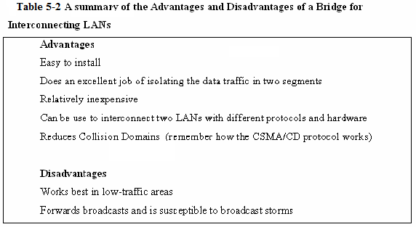
Table 5-2 A summary of the advantages and disadvantages of a Bridge interconnecting LANs.

Slide 25
Bridges - Today
A common application today using a bridge is interconnecting LANs using wireless technology.
The use of wireless bridges in LANs is a popular choice for interconnecting the LANs when the cost of physically connecting the LANs is prohibitive.

Slide 26
Network Switch (layer-2)
The layer-2 switch is an improved network technology that addresses the issue of providing direct data connections, minimizing data collisions, and maximizing the use of a LAN’s bandwidth, in other words, that improves the efficiency of the data transfer in the network.
The switch operates at layer 2 of the OSI model and therefore it uses the MAC or Ethernet address for making decisions for forwarding data packets. The switch monitors data traffic on its ports and collects MAC address information in the same way the bridge does to build a table of MAC addresses for the devices connected to its ports.

Slide 27
Network Switch (layer-2)
The switch has multiple ports similar to the hub and can switch in a data connection from any port to any other port similar to the bridge. This is why the switch is sometimes called a multiport bridge. The switch minimizes traffic congestion and isolates data traffic in the LAN.

Slide 28
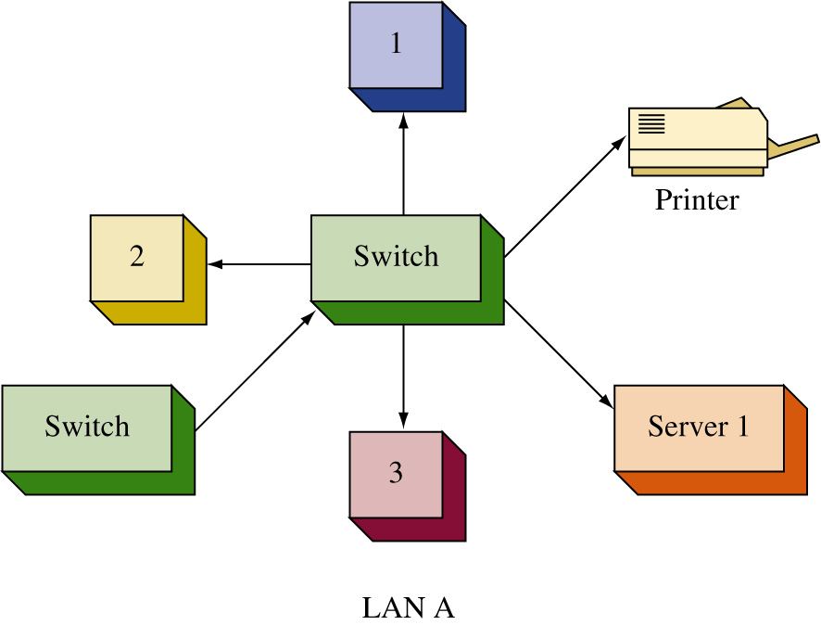
In this figure, the hub has been replaced with a switch. The change from a hub to a switch is relatively easy. The port connections are the same (RJ-45) and once the connections are changed and the device is powered on, the switch begins to make the direct data connections for multiple ports using layer 2 switching.

Slide 29
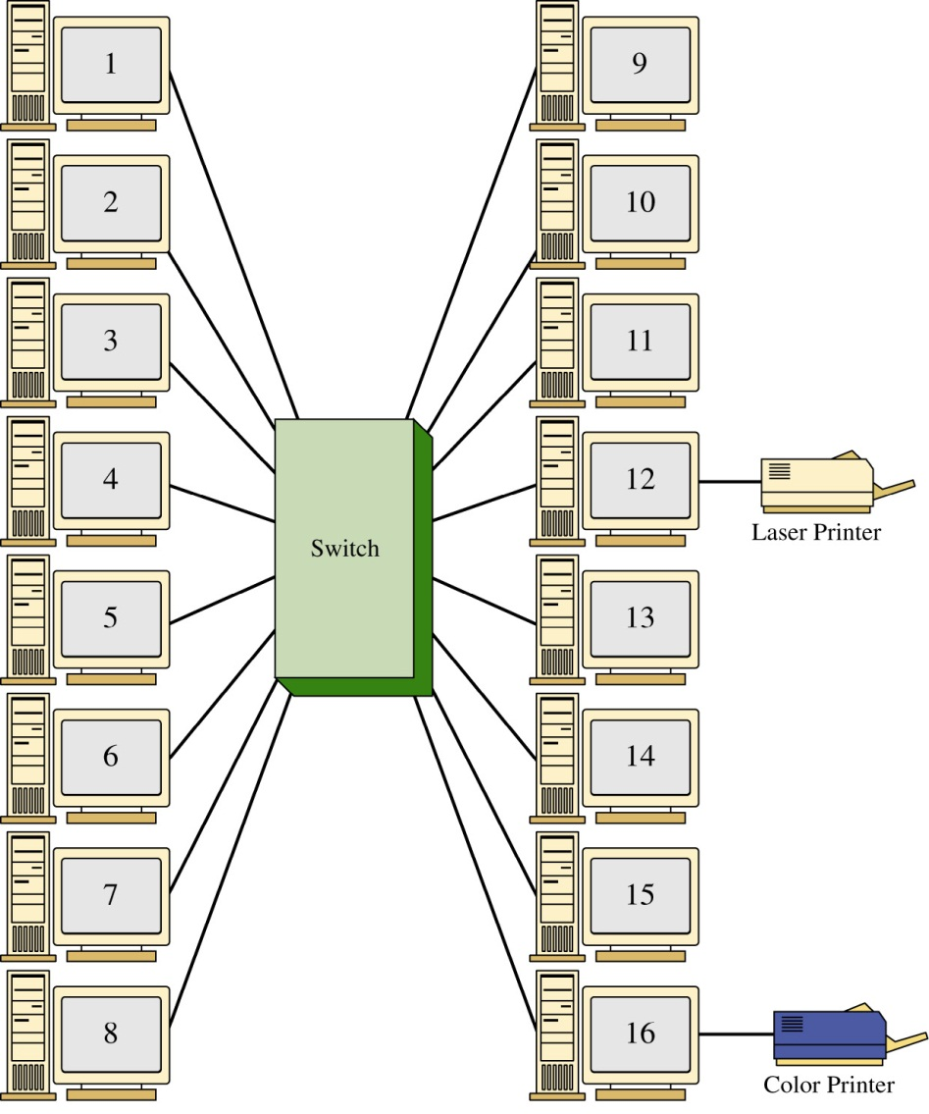
The LAN shown contains 14 computers and 2 printers connected to 16 ports on the switch. The LAN is configured in a star topology.
If the computer connected to port 1 is printing a file on the laser printer (port 12), the switch will set up a direct connect between ports 1 and 12. The computer at port 14 could also be communicating with the computer at port 7 and the computer at port 6 could be printing a file on the color printer at port 16.
The use of the switch enables simultaneous direct data connections for multiple pairs of hosts connected to the network. Each switch connection provides a link with minimal collisions and therefore maximum use of the LAN’s bandwidth.

Slide 30
The LAN shown contains 14 computers and 2 printers connected to 16 ports on the switch. The LAN is configured in a star topology.
If the computer connected to port 1 is printing a file on the laser printer (port 12), the switch will set up a direct connect between ports 1 and 12. The computer at port 14 could also be communicating with the computer at port 7 and the computer at port 6 could be printing a file on the color printer at port 16.
The use of the switch enables simultaneous direct data connections for multiple pairs of hosts connected to the network. Each switch connection provides a link with minimal collisions and therefore maximum use of the LAN’s bandwidth.

Slide 31
The LAN shown contains 14 computers and 2 printers connected to 16 ports on the switch. The LAN is configured in a star topology.
If the computer connected to port 1 is printing a file on the laser printer (port 12), the switch will set up a direct connect between ports 1 and 12. The computer at port 14 could also be communicating with the computer at port 7 and the computer at port 6 could be printing a file on the color printer at port 16.
The use of the switch enables simultaneous direct data connections for multiple pairs of hosts connected to the network. Each switch connection provides a link with minimal collisions and therefore maximum use of the LAN’s bandwidth.

Slide 32
The LAN shown contains 14 computers and 2 printers connected to 16 ports on the switch. The LAN is configured in a star topology.
If the computer connected to port 1 is printing a file on the laser printer (port 12), the switch will set up a direct connect between ports 1 and 12. The computer at port 14 could also be communicating with the computer at port 7 and the computer at port 6 could be printing a file on the color printer at port 16.
The use of the switch enables simultaneous direct data connections for multiple pairs of hosts connected to the network. Each switch connection provides a link with minimal collisions and therefore maximum use of the LAN’s bandwidth.

Slide 33
The LAN shown contains 14 computers and 2 printers connected to 16 ports on the switch. The LAN is configured in a star topology.
If the computer connected to port 1 is printing a file on the laser printer (port 12), the switch will set up a direct connect between ports 1 and 12. The computer at port 14 could also be communicating with the computer at port 7 and the computer at port 6 could be printing a file on the color printer at port 16.
The use of the switch enables simultaneous direct data connections for multiple pairs of hosts connected to the network. Each switch connection provides a link with minimal collisions and therefore maximum use of the LAN’s bandwidth.

Slide 34
The LAN shown contains 14 computers and 2 printers connected to 16 ports on the switch. The LAN is configured in a star topology.
If the computer connected to port 1 is printing a file on the laser printer (port 12), the switch will set up a direct connect between ports 1 and 12. The computer at port 14 could also be communicating with the computer at port 7 and the computer at port 6 could be printing a file on the color printer at port 16.
The use of the switch enables simultaneous direct data connections for multiple pairs of hosts connected to the network. Each switch connection provides a link with minimal collisions and therefore maximum use of the LAN’s bandwidth.

Slide 35
A link with minimal collisions is possible since only the two computers that established the link will be communicating over the channel.
Recall that in the star topology each host has a direct connection to the switch. Therefore, when the link is established between the two hosts, their link is isolated from any other data traffic.
However, the exception to this is when broadcast or multicast messages are sent in the LAN. In the case of a broadcast message, the message is sent to all devices connected to the LAN. A multicast message is sent to a specific group of hosts on the network.

Slide 36
Managed Switch
A managed switch is simply a network switch that allows the network administrator to monitor, configure, and manage certain network features such as what computers are allowed to access the LAN via the switch.
Access to the management features for the switch is password protected so that only the network administrators can gain entry.

Slide 37
Switches
The benefits of a using a network switch are many in a modern computer network. These benefits include less network congestion, faster data transfers, and excellent manageability. It has been shown that a network switch can be used to replace the network hub and the advantage is data traffic within a LAN is isolated.
The term for this is isolating the collision domains which is breaking the network into segments. A segment is a portion of the network where the data traffic from one part of the network is isolated from the other networking devices.

Slide 38
Switches
A direct benefit of isolating collision domains is there will be an increase in the data transfer speed and throughput. This is due to the fact that the LAN bandwidth is not being shared and chances of data collisions are minimized.
As a result, the LAN will exhibit faster data transfers and latency within the LAN will be significantly reduced. Reduced latency means that the data packets will arrive at the destination more quickly.

Slide 39
CAM – Content Addressable Memory
Switches learn the MAC addresses of the connected networking by extracting the MAC address information from the headers of Ethernet data packets.
The switch will map the extracted MAC address to the port where the data packet came in. This information is stored in CAM – Content Addressable Memory.
CAM is a table of MAC address and port mapping used by the switch to identify connected networking devices

Slide 40
CAM – Content Addressable Memory
The extracted MAC addresses are then used by the switch to map a direct communication between two network devices connected to its ports.
The MAC address and port information remain in CAM as long as the device connected to the switch port remains active.
A time-stamp establishes the time when the mapping of the MAC address to a switch port is established.
switches limit the amount of time address and port information are stored in CAM. This is called aging time.

Slide 41
Switches – broadcast domain
It has been shown that switches minimize the collision domain due to the fact a direct switch connection is made between networking devices.
However, it is important to remember that switches do not reduce the broadcast domain.
In a broadcast domain, any network broadcast sent over the network will be seen by all networking devices in the same network.
Broadcasts within a LAN will be passed by switches

Slide 42
Switches – modes
There are two modes used in a switch to forward frames.
These are store-and-forward and cut-through.

Slide 43
Switchmodes – Store and Forward
Store-and-Forward - In this mode, the entire frame of data is received before any decision is made regarding forwarding the data packet to its destination.
There is switch latency in this mode because the destination and source MAC addresses must be extracted from the packet and the entire packet must be received before it is sent to the destination.
The term switch latency is the length of time a data packet takes from the time it enters a switch until it exits.

Slide 44
Switchmodes – Store and Forward
An advantage of the store-and-forward mode is the switch checks the data packet for errors before it is sent on to the destination.
A disadvantage is lengthy data packets will take a longer time before they exit the switch and are sent to the destination.

Slide 45
Switchmodes – Cut-Through
in this mode, the data packet is forwarded to the destination as soon as the destination MAC address has been read.
This minimizes the switch latency however, no error detection is provided by the switch.
There are two forms of cut-through switching; Fast-Forward and Fragment Free.

Slide 46
Switchmodes – Cut-Through Fast-Forward
this mode offers the minimum switch latency.
The received data packet is sent to the destination as soon as the destination MAC address is extracted.

Slide 47
Switchmodes – Cut-Through Fragment-Free
in this mode, fragment collisions are filtered out by the switch.
Fragment-collisions are collisions that occur within the first 64 bytes of the data packet. Recall from Chapter 1, Table 1-1 that the minimum Ethernet data packet size is 64 bytes.
The collisions create packets smaller than 64 bytes and these fragments are discarded.
Latency is measured from the time the first bit is received until it is transmitted.

Slide 48
Switchmodes – Cut-Through Adaptive Cut-Through
This is a combination of the store-and-forward mode and cut-through.
The cut-through mode is used until an error-threshold (errors in the data packets) has been exceeded.
The switch mode changes from cut-through to store-and-forward after the error threshold has been exceeded.

Slide 49
Multilayer Switches
Layer 3 switches work at the network layer of the OSI model and use IP addressing for making decisions to route a data packet the best direction. Layer 3 switches are similar to routers in that they also work at layer 3 and use the network address for making routing decisions.
Layer 4 switches operate at the transport layer of the OSI model. Layer 4 coordinates the communications between network systems. The layer 4 switch identifies the application protocols included with each packet and can then hand off the packet to the appropriate higher level software.

